Slide 1
Adding and Subtracting
Directed Numbers
Year 10 OLNA Mathematics

Slide 2


Slide 3
24
7
30
Integers
Date
EQ – What are directed numbers and how do I perform calculations with them?
Integers as _______and _______whole numbers, including 0.
Positive integers are all the whole numbers ________ than zero {1,2,3,4,5,...}
Negative integers are all the ________ of those whole numbers {-1,-2,-3,-4,-5,...}
Zero is neither _______ or __________.
-5 is the opposite of __ and -243 is the opposite of ___. If an integers is greater than zero (> 0), we say it’s sign is _________ (__). If it’s less than zero (__ 0), we say it’s sign is _________ (___)
Summary:
Notes:
Print these off for students to fill in

Slide 4
24
7
30
Integers
Date
EQ – What are directed numbers and how do I perform calculations with them?
Integers as positive and negative whole numbers, including 0.
Positive integers are all the whole numbers greater than zero {1,2,3,4,5,...}
Negative integers are all the opposites of those whole numbers {-1,-2,-3,-4,-5,...}
Zero is neither positive or negative.
-5 is the opposite of 5 and -243 is the opposite of 243. If an integers is greater than zero (> 0), we say it’s sign is positive (+). If it’s less than zero (< 0), we say it’s sign is negative (-)
Summary:

Slide 5

24
7
30
Intergers
Date
EQ – What are directed numbers and how do I perform calculations with them?
Integers as positive and negative whole numbers, including 0
Positive and negative integers together are called directed numbers. Directed numbers show both ____________ and ___________ (size).
Ex: +7 or 7 means 7 units in the positive direction, while -3 means 3 units in the negative direction.
**Can you think of some everyday examples of negative integers?**
Integers are represented by the number line
Negative
Positive
Notes:
Print off for students to add in

Slide 6
24
7
30
Intergers
Date
EQ – What are directed numbers and how do I perform calculations with them?
Integers as positive and negative whole numbers, including 0
Positive and negative integers together are called directed numbers. Directed numbers show both direction and magnitude (size).
Ex: +7 or 7 means 7 units in the positive direction, while -3 means 3 units in the negative direction.
**Can you think of some everyday examples of negative integers?**
Integers are represented by the number line
Negative
Positive

Slide 7
Top 10 Coldest Recorded Temperatures on Earth
TV4Education link: https://baldivissc.functionalsolutions.com.au/SmartLibraryWeb/SmartLibraryPageLoader.aspx?PageName=TITLE_DETAIL&BookID=%2f2vph4WGeMWo%2bOhFXQXkEEHRJTIUspuAbAkVpVSE%2fWc%3d
Youtube link: https://www.youtube.com/watch?v=0DKaD_htPPk&t=138s

Slide 8
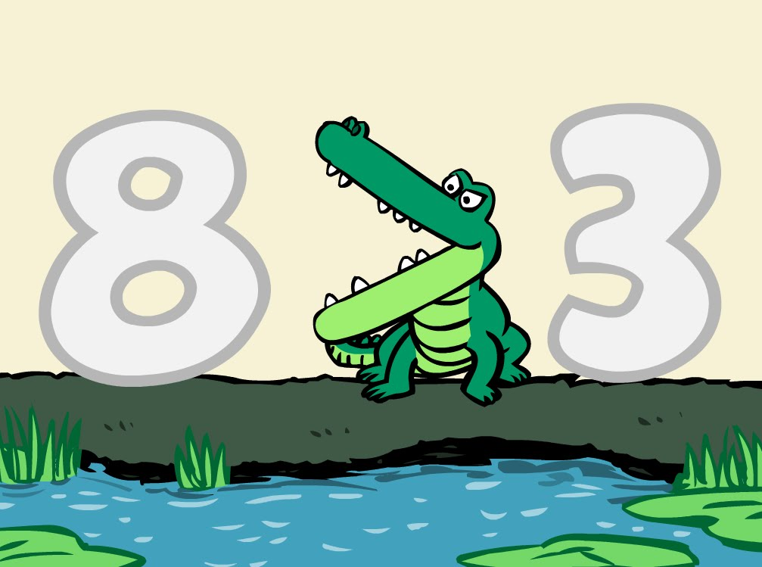
24
7
30
Intergers
Date
EQ – What are directed numbers and how do I perform calculations with them?
For any two different places on the number line, the integer on the right is greater than the integer on the left.
Ex: 8 is greater (or more) than 3.
This can be written as 8 > 1
Think of the > and the < signs as the jaws of a crocodile.
They always open towards the bigger number and point to the smaller number (the smaller number eats the bigger number).

Slide 9

Do you understand? Fists of Five
Notes:
Check for Understanding

Slide 10
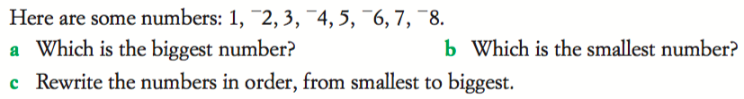
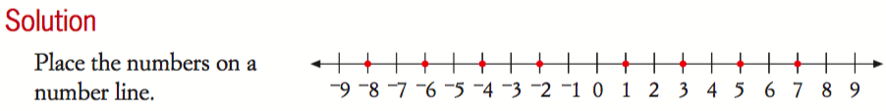

Slide 11

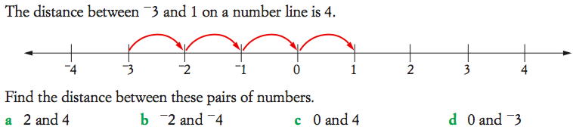

Slide 12
Adding and Subtracting Integers
https://www.youtube.com/watch?v=DBSviXhkubg
Notes:
The first operation tells us what end of the number line to face ( + face the positive end of number line) ( - face the negative end of number line)
The second operation and number tells us how far to move and in what direction (forward if it is positive and backwards if it is negative)

Slide 13


24
7
30
Date
Adding and Subtracting Integers
EQ – How do we add and subtract integers?
Subtraction
Addition
Which direction do we go?
Subtraction we go left!
Addition we go right!
Positive integers
5 + 2
5 - 2
Start at 5 and go to the right 2
Get to 7
Start at 5 and go to the left 2
Get to 3
Notes:
The first operation tells us what end of the number line to face ( + face the positive end of number line) ( - face the negative end of number line)
The second operation and number tells us how far to move and in what direction (forward if it is positive and backwards if it is negative)

Slide 14
24
7
30
Date
Adding and Subtracting Integers
EQ – How do we add and subtract integers?
Subtraction
Addition
Think of negative numbers as the same as subtracting the number
What about adding negative numbers?
5 + -2
-2 + -2
Start at 5
+ means we are heading
But we are not adding a normal positive number. It is -2 so we turn around and go the opposite way.
What do we do for this one??
Notes:
The first operation tells us what end of the number line to face ( + face the positive end of number line) ( - face the negative end of number line)
The second operation and number tells us how far to move and in what direction (forward if it is positive and backwards if it is negative)

Slide 15
24
7
30
Date
Adding and Subtracting Integers
EQ – How do we add and subtract integers?
Subtraction
Addition
What about subtracting with negative numbers?
-3 - -2=
Start at -3 and……
4 - -3=
Notes:
The first operation tells us what end of the number line to face ( + face the positive end of number line) ( - face the negative end of number line)
The second operation and number tells us how far to move and in what direction (forward if it is positive and backwards if it is negative)

Slide 16
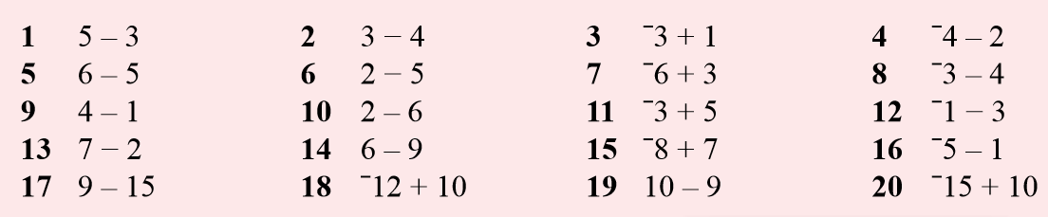
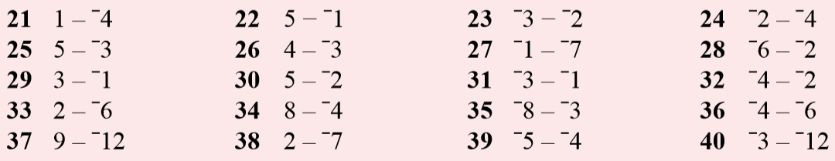
Task Side Practice (use your number line!)

Slide 17
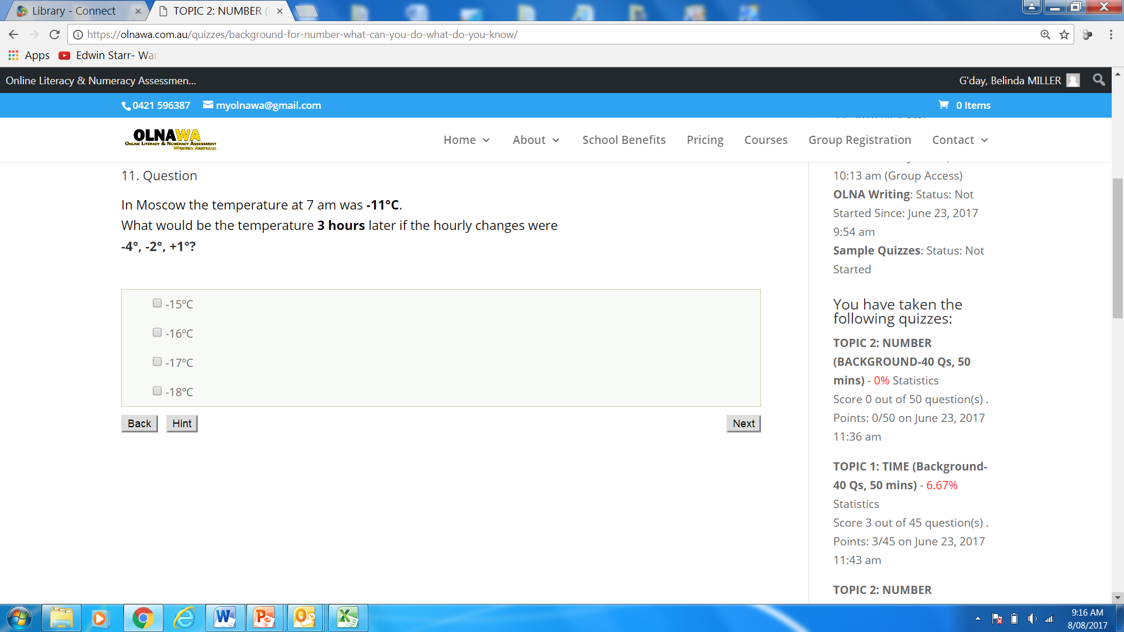

Slide 18
TASK
Directed numbers worksheet x3

